Slide 1
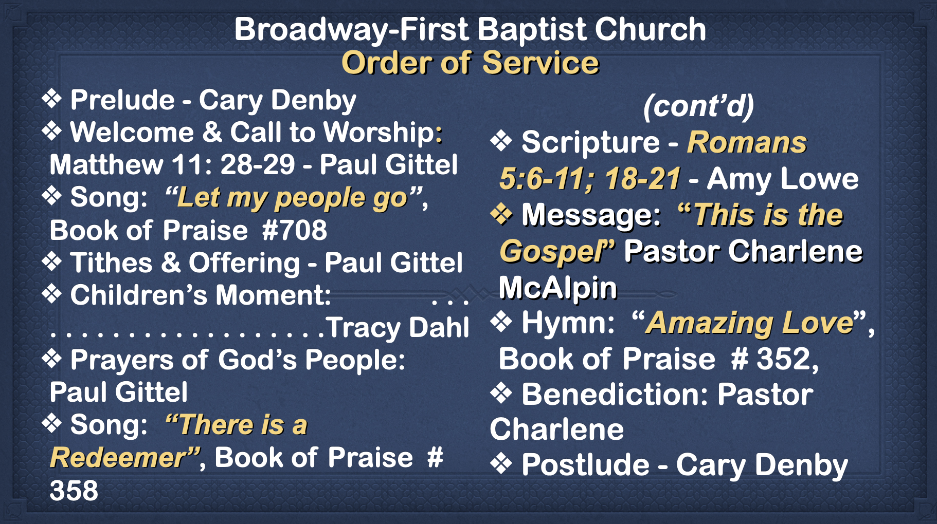

Slide 2
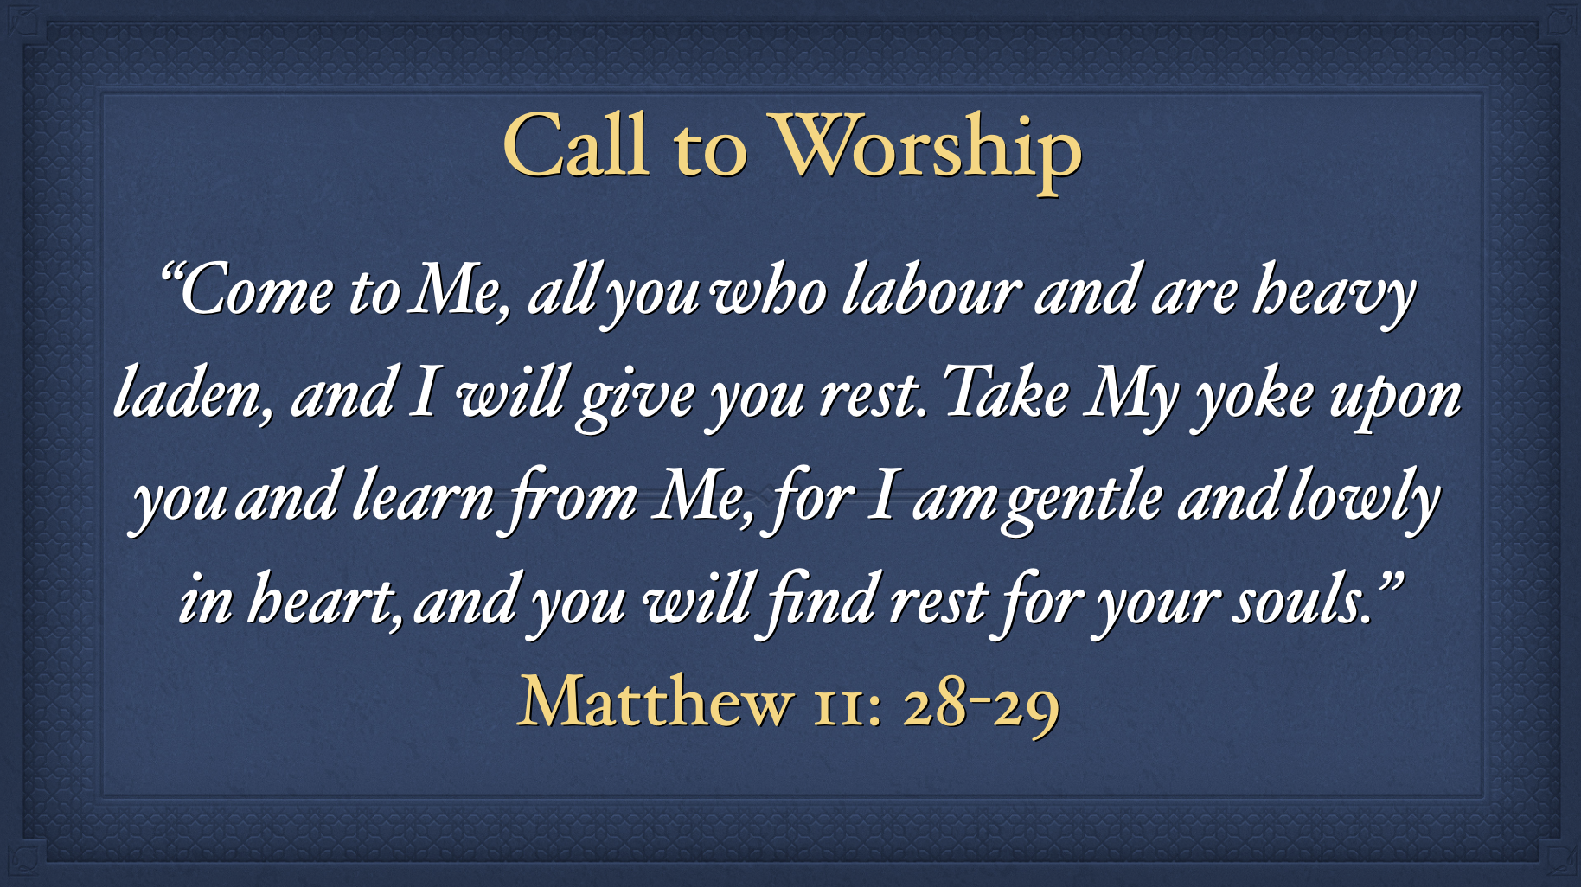

Slide 3
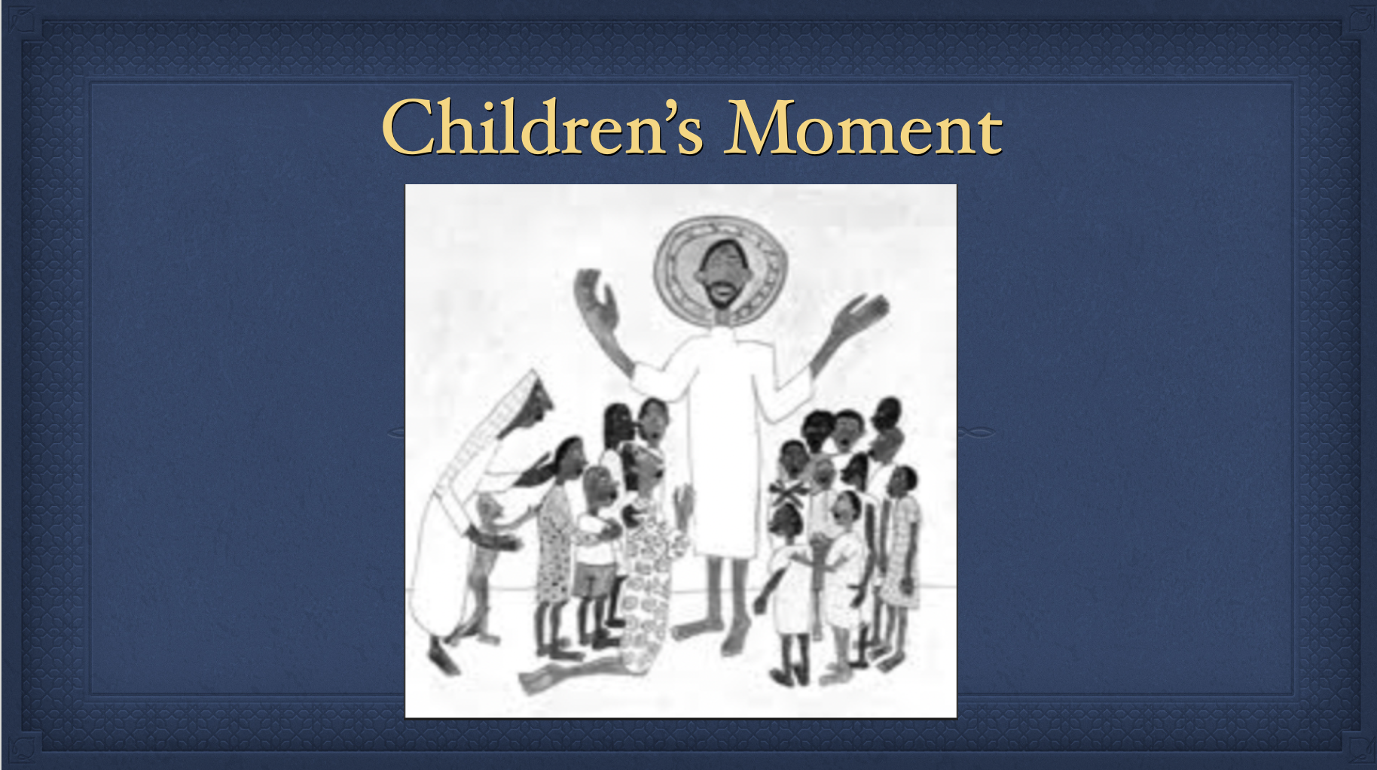

Slide 4
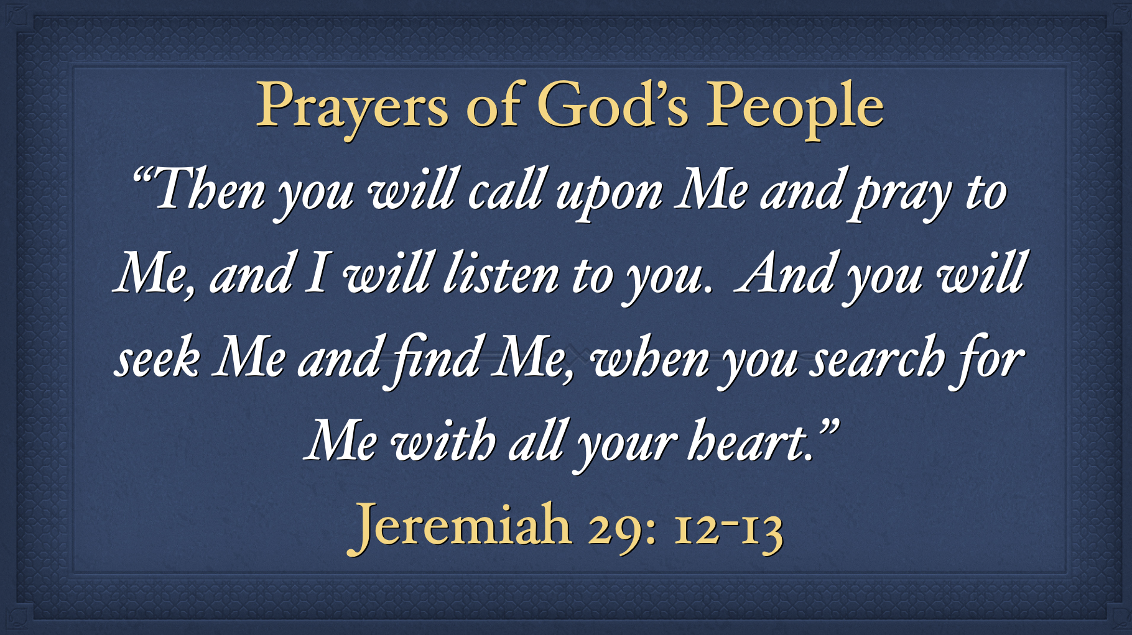

Slide 5
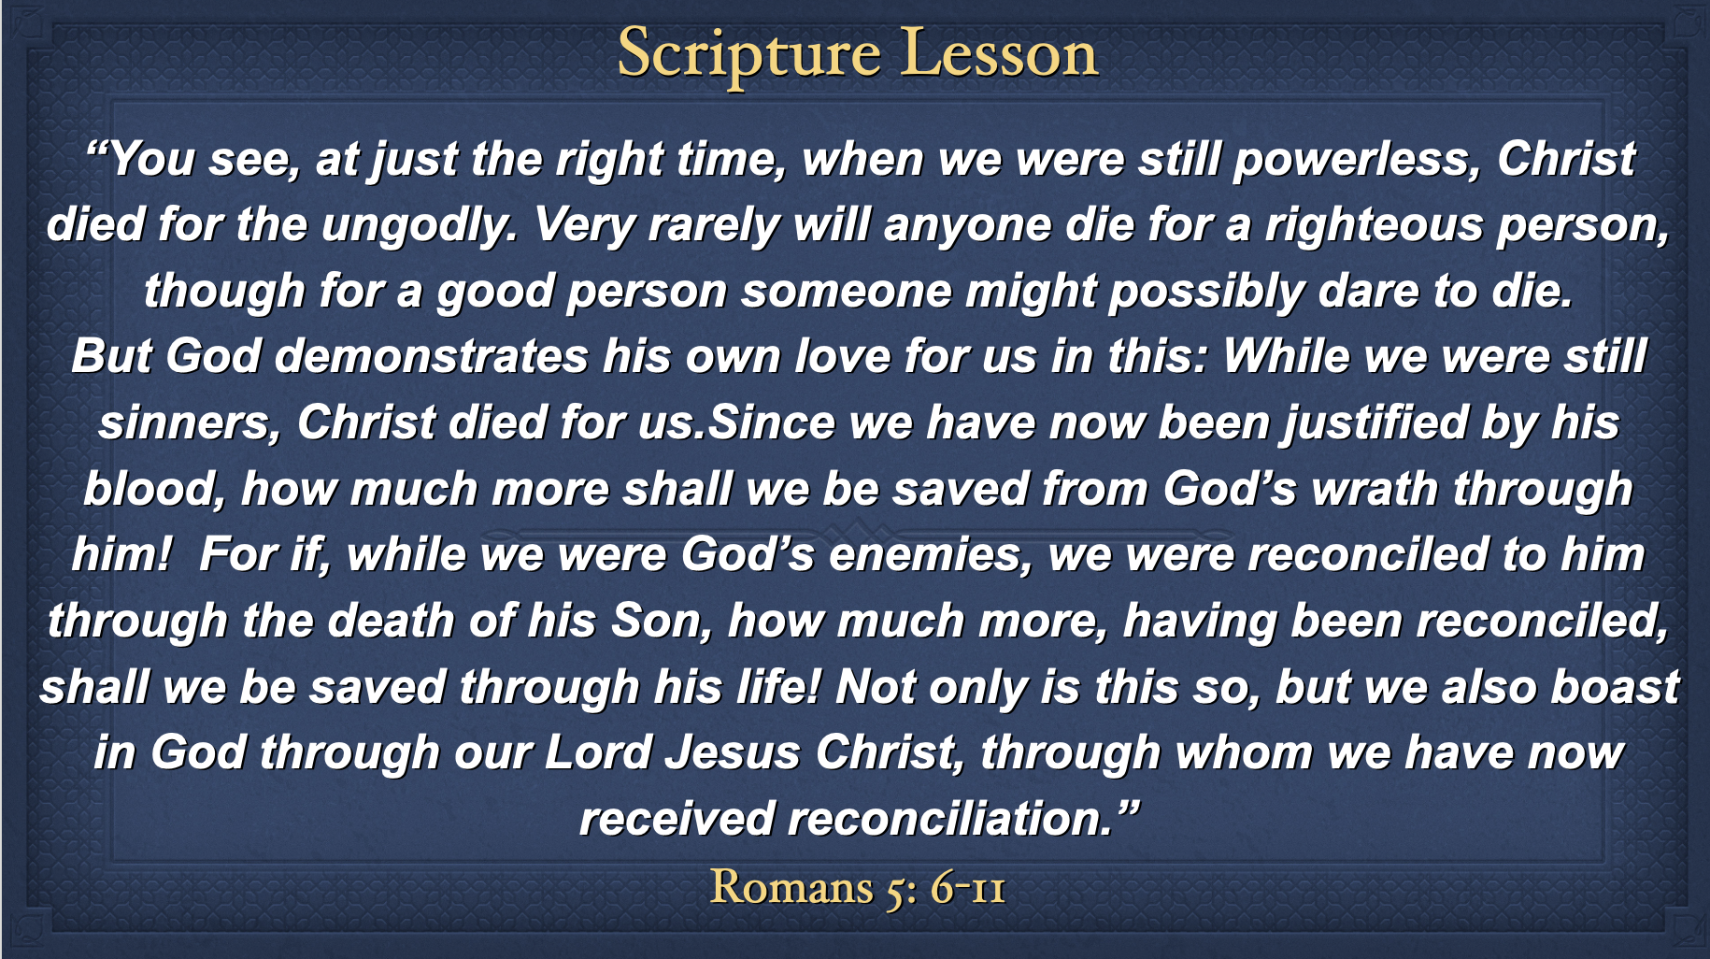

Slide 6
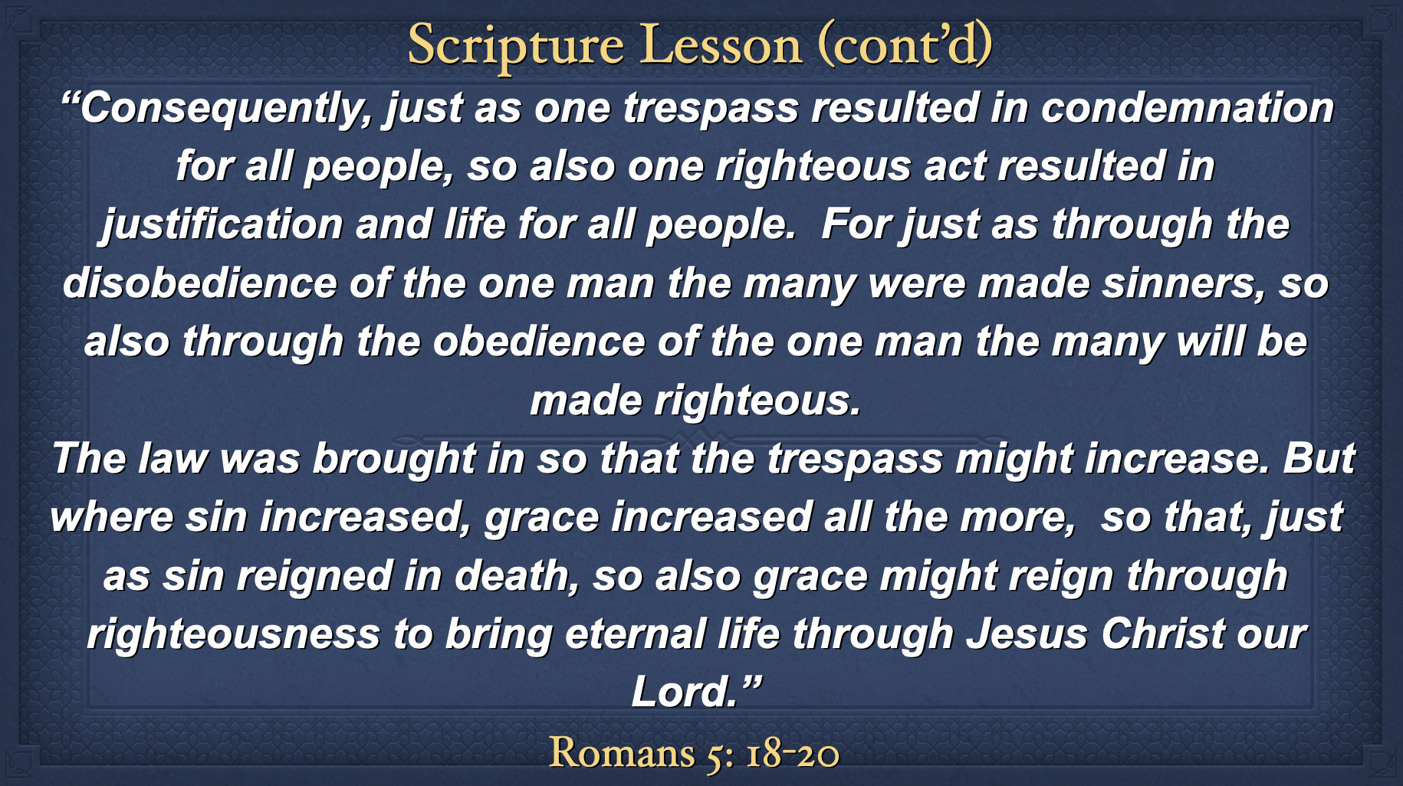

Slide 8
Broadway-First Baptist Church
Order of Service
Prelude - Cary Denby
Welcome & Call to Worship: Matthew 11: 28-29 - Paul Gittel
Song: “Let my people go”, Book of Praise #708
Tithes & Offering - Paul Gittel
  Children’s Moment: . . . . . . . . . . . . . . . . . . . . .Tracy Dahl
Prayers of God’s People: Paul Gittel
Song: “There is a Redeemer”, Book of Praise # 358
(cont’d)
Scripture - Romans 5:6-11; 18-21 - Amy Lowe
Message: “This is the Gospel” Pastor Charlene McAlpin
Hymn: “Amazing Love”, Book of Praise # 352,
  Benediction: Pastor Charlene
  Postlude - Cary Denby

Slide 9
Call to Worship
“Come to Me, all you who labour and are heavy laden, and I will give you rest. Take My yoke upon you and learn from Me, for I am gentle and lowly in heart, and you will find rest for your souls.”
Matthew 11: 28-29

Slide 10
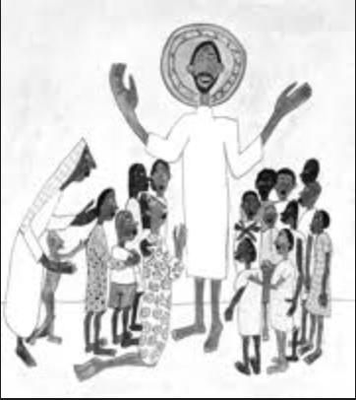
Children’s Moment

Slide 11
Prayers of God’s People
“Then you will call upon Me and pray to Me, and I will listen to you. And you will seek Me and find Me, when you search for Me with all your heart.”
Jeremiah 29: 12-13

Slide 12
Scripture Lesson
“You see, at just the right time, when we were still powerless, Christ died for the ungodly. Very rarely will anyone die for a righteous person, though for a good person someone might possibly dare to die.
But God demonstrates his own love for us in this: While we were still sinners, Christ died for us.Since we have now been justified by his blood, how much more shall we be saved from God’s wrath through him! For if, while we were God’s enemies, we were reconciled to him through the death of his Son, how much more, having been reconciled, shall we be saved through his life! Not only is this so, but we also boast in God through our Lord Jesus Christ, through whom we have now received reconciliation.”
Romans 5: 6-11

Slide 13
Scripture Lesson (cont’d)
“Consequently, just as one trespass resulted in condemnation for all people, so also one righteous act resulted in justification and life for all people. For just as through the disobedience of the one man the many were made sinners, so also through the obedience of the one man the many will be made righteous.
The law was brought in so that the trespass might increase. But where sin increased, grace increased all the more, so that, just as sin reigned in death, so also grace might reign through righteousness to bring eternal life through Jesus Christ our Lord.”
Romans 5: 18-20

